Slide 1

Sustainable Development Goal
Lung Cancer Awareness

Slide 2
Participants
Bhushan Waghode ADT23MGTM0921@students.mituniversity.edu.in
Abhijit Pilane ADT23MGTM0904@students.mituniversity.edu.in
Ayush Yelwankar ADT23MGTM0917@students.mituniversity.edu.in
Miraj Patil ADT23MGTM0940@students.mituniversity.edu.in
Ayush Kumar Srivastav ADT23MGTM0918@students.mituniversity.edu.in
Aarti Khamkar ADT23MGTM0903@students.mituniversity.edu.in
Swati Mishra.y.edu.in ADT23MGTM0979@students.mituniversity.edu.in
Shivani Kale ADT23MGTM0966@students.mituniversity.edu.in

Slide 3
Sustainable Development Goal
Our Model is bulid for lung cancer awareness comes under the “Good health and Well being”

Slide 4
TABLE OF CONTENTS
01
Problem statement
Rationale behind it
02
Tools used for designing
How and Why
03
04
Data used
Link and Screenshots
05
06

Slide 5

Problem Statement
Many people are unaware of the early symptoms of lung cancer, leading to delayed diagnosis and treatment .
Patients and their families may be unaware of the resources available to them, such as support groups, financial assistance programs, and palliative care services .

Slide 6

Rationale behind it
Developing and implementing public health platform to educate the general population about the early signs and symptoms of lung cancer.
Creating a centralized platform or resource hub to provide information on available support services for lung cancer patients and their families.

Slide 7
Tools used for designing
IBM watsonx assistant
IBM Watson Assistant, also known as Watsonx Assistant, is a tool that allows you to build chatbots and virtual assistants for various purposes. These chatbots can understand natural language and respond to user queries in a conversation.
Cloud Object Storage
Object storage can automatically replicate data and store it across multiple devices and geographical locations. This can help protect against outages, safeguard against data loss, and help support disaster recovery strategies.

Slide 8
Watson Studio
IBM Watson® Studio empowers data scientists, developers and analysts to build, run and manage AI models, and optimize decisions anywhere on IBM Cloud Pak® for Data. Unite teams, automate AI lifecycles and speed time to value on an open multicloud architecture.

Slide 9
How and Why?
Personalized Risk Assessment: AI can analyze personal data such as age, smoking history, family history, and other health factors to provide users with a personalized risk assessment for lung cancer.
Symptom Checker: An AI-driven symptom checker can help users identify potential symptoms of lung cancer based on their inputs, offering guidance on whether they should seek medical advice.
Educational Content: AI can curate and present the most relevant and up-to-date information on lung cancer, including symptoms, risk factors, prevention strategies, and treatment options, tailored to the user's knowledge level and preferences.
nteractive Q&A: AI chatbots can answer user questions in real-time, providing instant support and information on lung cancer-related queries.
Screening Recommendations: Based on the user's risk profile and symptoms, AI can recommend appropriate screening tests and provide information on nearby healthcare facilities where these tests can be conducted.

Slide 10
Why?
Convenience: It's easier and faster to search online than to make an appointment and visit a doctor.
Immediate Information: The internet provides instant access to a vast amount of information, allowing users to quickly learn about their symptoms and potential conditions.
Anonymity: People may feel more comfortable searching for sensitive or embarrassing health issues online rather than discussing them face-to-face with a healthcare provider.
Preliminary Research: Individuals often want to gather information about their symptoms to determine whether a doctor's visit is necessary or to prepare for a more informed discussion with their healthcare provider.

Slide 11
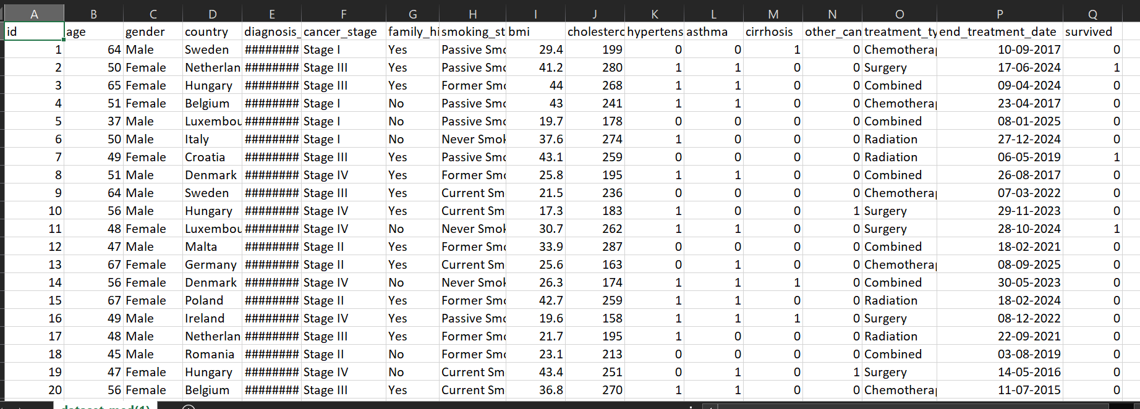
Data used

Slide 12
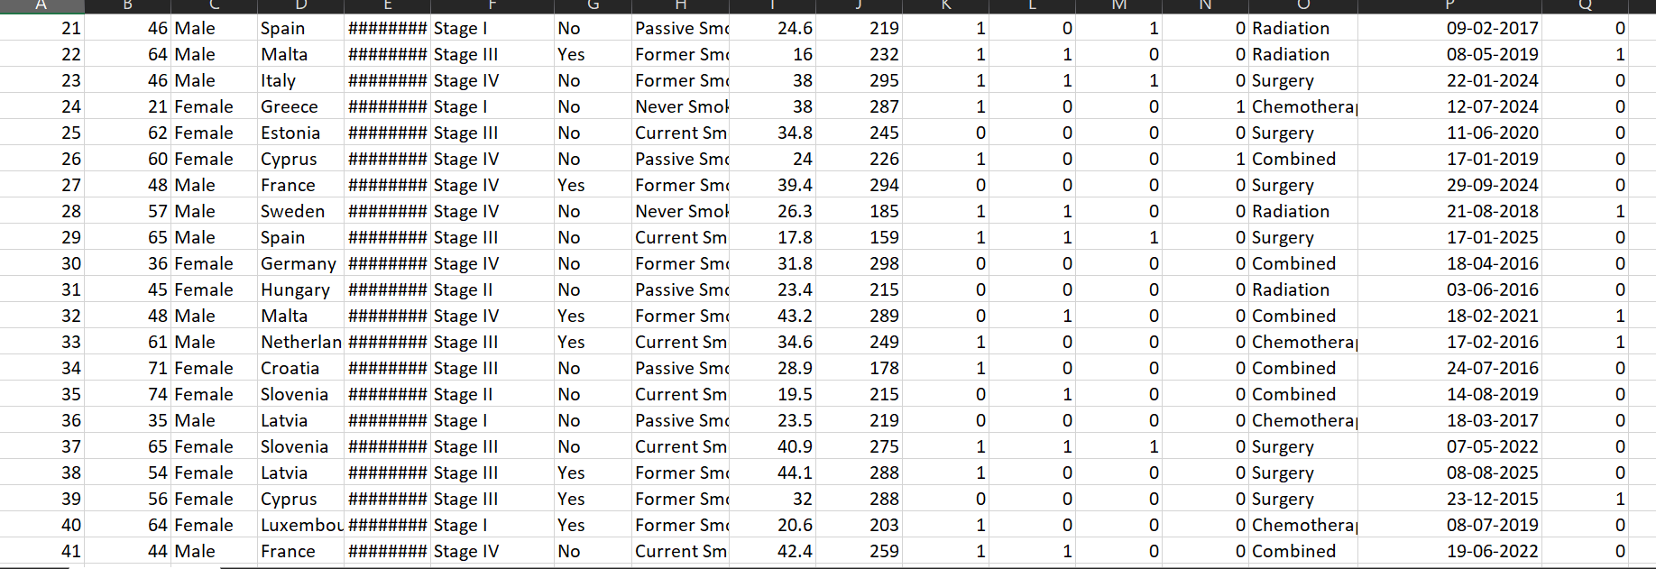
This data has been taken from keggle for more details you can visit to this link:-

Slide 13

A PICTURE IS WORTH A THOUSAND WORDS

Slide 14
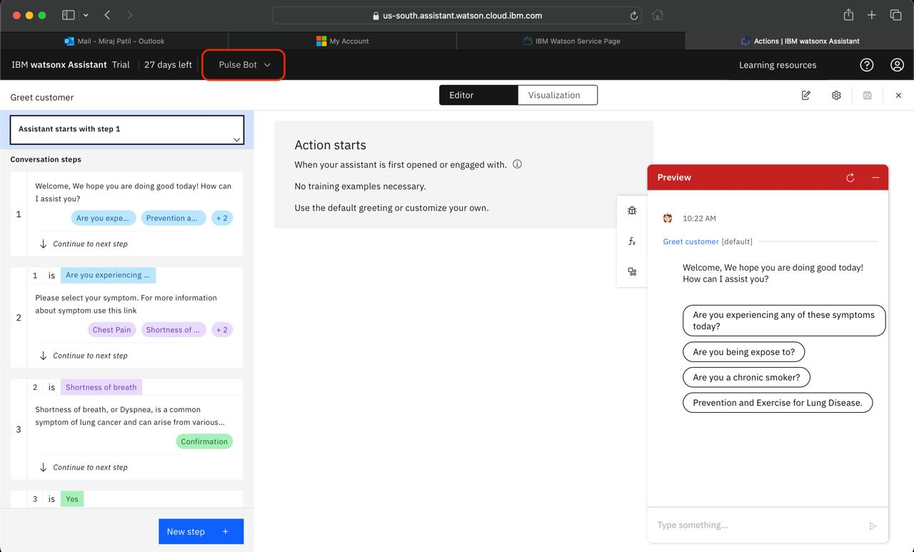
Link and screenshots
explanation:- Here our Chatbot is created and it is fully functional but we faced some issues after completing it.

Slide 15
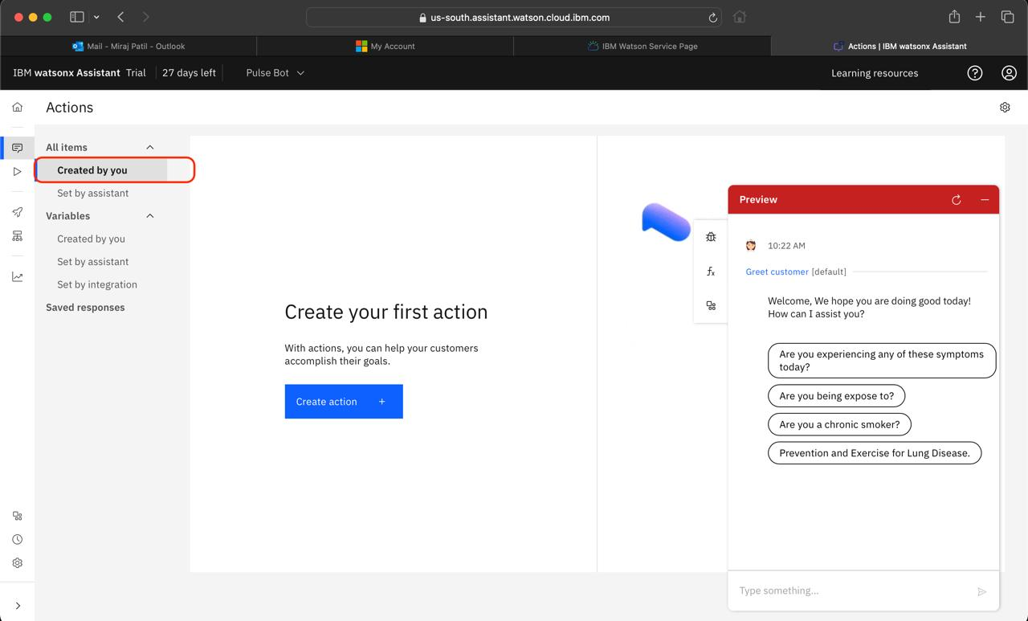
Explanation- after creating a chatbot and entered into actions we were not able to see my chatbot in 'created by you' tab rather it was showing in 'set by assistant' tab

Slide 16
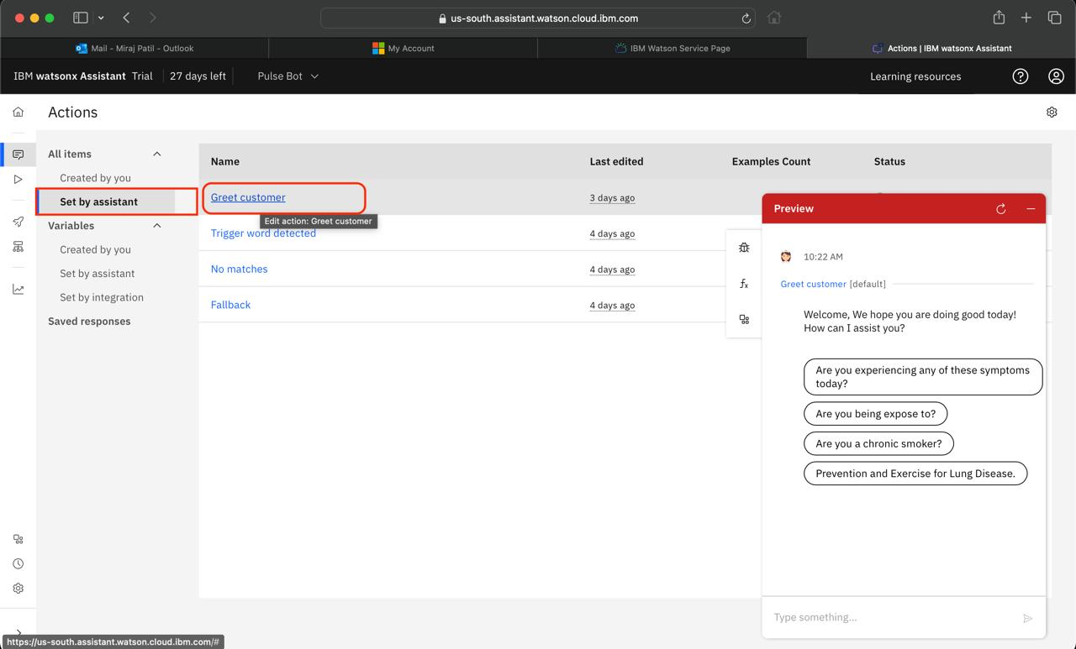
Our chatbot was present in this tab so because of that I was not able to copy my chatbot and make it live on our website

Slide 17
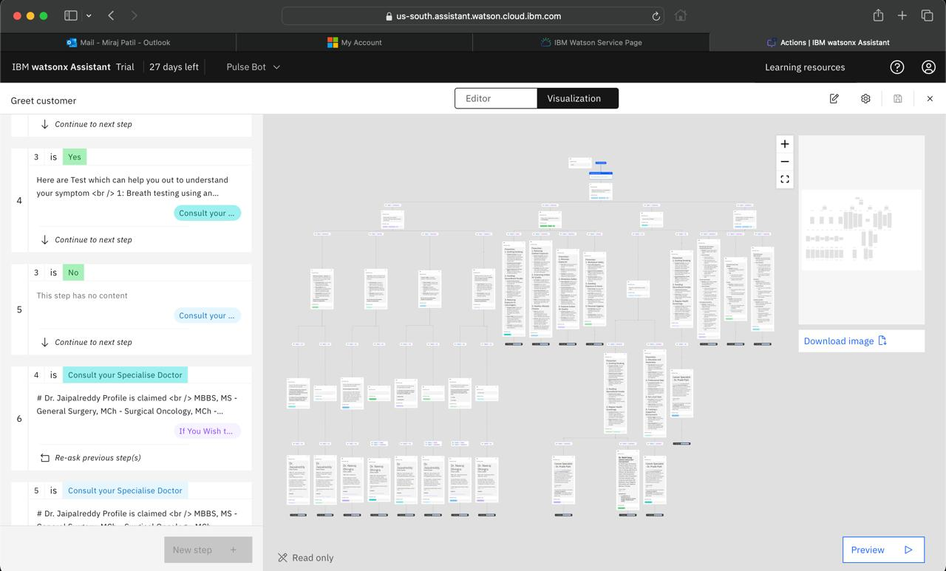
The following is the visualization of our chatbot

Slide 18
Reference video regarding the chatbot will be mentioned in the google drive please do check.
Link:-

Slide 19
Lung Cancer Predictor
Folder Link :-
https://drive.google.com/drive/folders/1iJGlLOM3oLQQn5CMrvuECA5NmqIJeeTp?usp=drive_link
Folder Contents : -
1. Notebook(Lung Cancer) - Model
2. ChatBot Operational Video
3. Data Set :- meddata.csv
4. Lung Cancer Report.

Slide 20
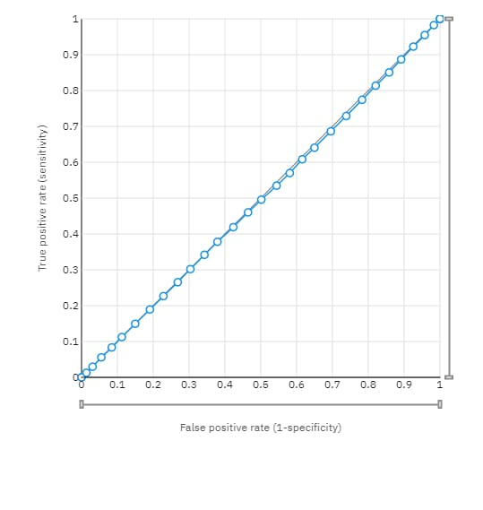
This image depicts a Receiver Operating Characteristic (ROC) curve, which is used to evaluate the performance of a binary classifier system.
This type of analysis is crucial in fields like medical diagnostics, where the ability to accurately distinguish between conditions (e.g., presence or absence of a disease) is vital.

Slide 21
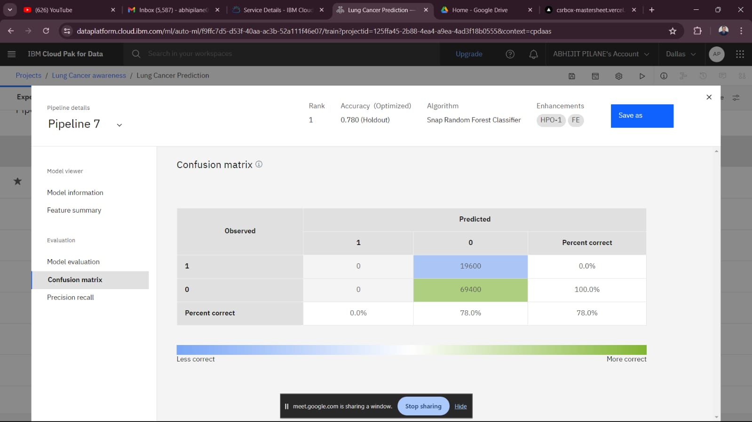
This image shows a confusion matrix from an IBM Cloud Pak for Data platform, evaluating a machine learning model (Snap Random Forest Classifier) used for lung cancer prediction.
The model has a significant flaw in identifying lung cancer cases (true positives). This performance needs improvement, particularly in sensitivity, to be a reliable tool for lung cancer prediction.

Slide 22
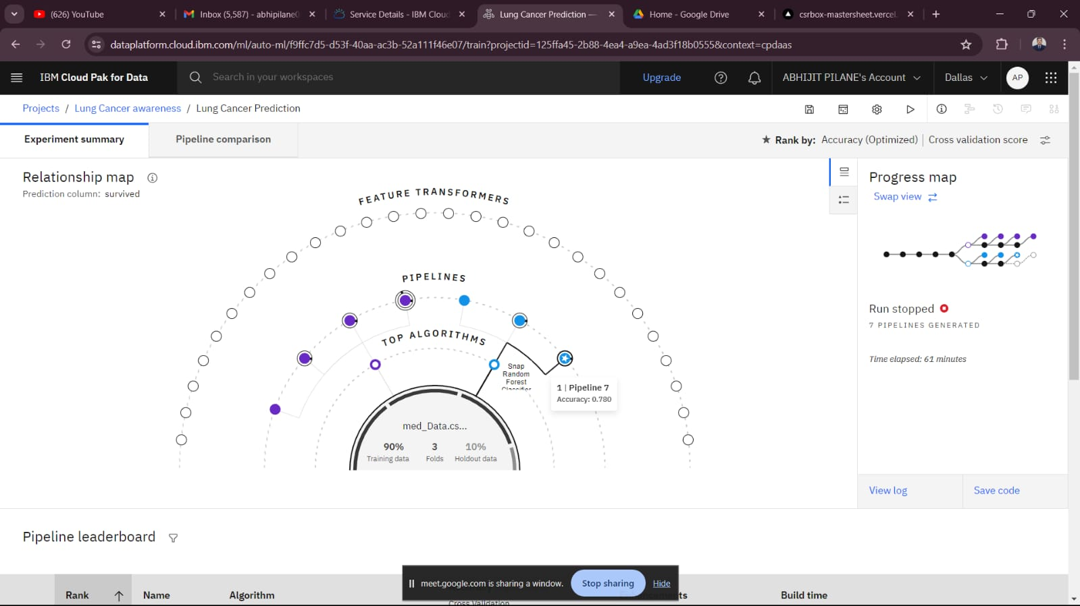

Slide 23
Relationship Map
Prediction Column:
survived: The target variable for prediction in this experiment is whether the patient survived.
Feature Transformers: The outer circle represents various feature transformation techniques applied to the data.
Pipelines: The middle circle shows the different pipelines generated during the experiment. Each pipeline represents a combination of data preprocessing steps and machine learning algorithms.
Top Algorithms: The inner circle highlights the different algorithms tested. The highlighted one here is the Snap Random Forest Classifier.
Specific Pipeline
Pipeline 7: This pipeline is highlighted as it ranks first in terms of accuracy.
Accuracy: 0.780 (78%)
.Algorithm: Snap Random Forest Classifier.Training Data: 90% of the data was used for training.
Validation: 3-fold cross-validation was used.
Holdout Data: 10% of the data was reserved as holdout data for final evaluation.

Slide 24
THANKS!
Do you have any questions?

